Slide 1
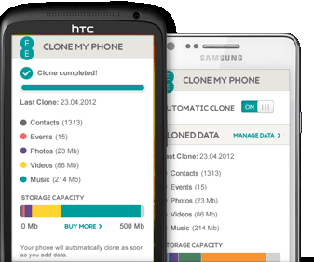
MOBILE CLONING
AND
DETECTION TECHNIQUES
Project By:
Akash Sinha Roll No. :03796502710
Alok Roll No. : 04796502710
Ajay Roll No. : 05096502710
Harshit Trivedi Roll No. : 06496502710

Slide 2
CONTENTS
Introduction
Objective of project
Operating Environment
Description about software used
Installation and process to run the project.
References

Slide 3
INTRODUCTION
Mobile cloning is the process of copying the identity of one mobile phone to another mobile phone.
The phones do not have to be the same model or even the same brand.
The second phone is now for all purposes the same as the first. It will ring if one when the original phones rings. It will cause any charges incurred, to be billed on the original phone's monthly billing statement.

Slide 4
OBJECTIVE
The main objective of this project is to detect Mobile Cloning virtually through a Client – Server interface in order to prevent malicious or criminal intent.

Slide 5
OPERATING ENVIRONMENT
Minimum Hardware Requirement Of Client Side:
Processor : 2.6 GHz Intel Pentium IV or Equivalent
Memory : 512 MB RAM
Disk Space : 1 GB of free disk space
15 in. Color Monitor
Standard 104 Keys Keyboard

Slide 6
SOFTWARE REQUIREMENT
Minimum Software Requirement Of Client Side:
Operating System : Windows 2000/XP or above
MySQL 5.0
SQLyog 5.0
JDK (ver 7.2)
NetBeans IDE (ver 7.2) etc.

Slide 7
SOFTWARES USED
NetBeans IDE is an open-source integrated development environment. NetBeans IDE supports development of all Java application types (Java SE(including JavaFX), Java ME, web, EJB and mobile applications) out of the box.
MySQL is the world's most widely used relational database management system (RDBMS) that runs as a server providing multi-user access to a number of databases, though SQLite probably has more total embedded deployments. The SQL phrase stands for Structured Query Language.
SQLyog is a GUI tool for the RDBMS MySQL. It is developed by Webyog, Inc. based out of Bangalore, India and Santa Clara, California.

Slide 8
HOW WIRELESS TECHNOLOGY WORKS
Each cellular phone has a unique pair of identifying numbers: the electronic serial number(“ESN”) and the mobile identification number (“MIN”).
The ESN is programmed into the wireless phone’s microchip by the manufacturer at the time of production.
The MIN is a ten-digit phone number that is assigned by the wireless carrier to a customer when an account is opened.

Slide 9
When a cellular phone is first turned on, it emits a radio signal that broadcasts these numbers to the nearest cellular tower.
The phone will continue to emit these signals at regular intervals, remaining in contact with the nearest cellular tower.
These emissions allow computers at the cellular carrier to know how to route incoming calls to that phone, to verify that the account is valid so that outgoing calls can be made, and to provide the foundation for proper billing of calls.
This autonomous registration occurs whenever the phone is on, regardless of whether a call is actually in progress.

Slide 10
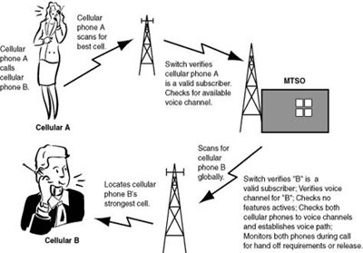
MOBILE PHONE COMMUNICATION

Slide 11
HOW IS A MOBILE CLONED ?
To clone one requires the extraction of the ESN (Electronic Serial Number) from the Master Phone and insertion into the phone to be cloned. This is done in older phones by removing the PROM or EPROM holding the ESN, and other data, and copying it. In newer phones, the data is removed via a serial cable connection to a computer.

Slide 12
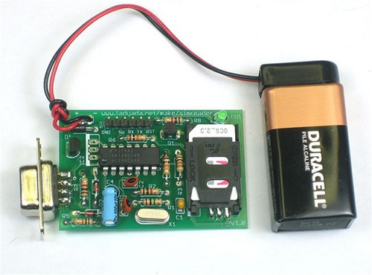
A file is made from the original extracted data changing data as necessary. Once a computer file has been made, a second blank chip, the same type as in the phone to be cloned, is then reprogrammed with the ESN and other data from the master. The entire procedure can be completed within 1 hour.

Slide 13
HOW TO DETECT CLONED PHONES ?
Duplicate Detection : The network sees the same phone in several places at the same time. Reactions include shutting them all off so that the real customer will contact the operator because he lost the service he is paying for, or switch to another clone but the real user will contact the operator.
Velocity Trap : The mobile phone seems to be moving at impossible , or most unlikely speeds. For example, if a call is first made in Helsinki, and five minutes later, another call is made but this time in Tampere, there must be two phones with the same identity on the network.

Slide 14
CONTD……
Call Counting : Both the phone and the network keep track of calls made with the phone, and should they differ more than the usually allowed one call, service is denied.
PIN codes : Prior to placing a call , the caller unlocks the phone by entering a pin code and then call as usual. After the call has been completed , the user locks the phone by entering the pin code again. Operators may share PIN information to enable safer roaming.

Slide 15
WHAT WE HAVE DONE ??
We have used the technique of Duplicate Detection and velocity trap to virtually detect cloning of two numbers.
We have used MySQL as Server having a database which stores all the information of a client registered to it.
When a new client is registered a thread is generated which stores all the information in SQL server which has a database.
When another client registers with the same number a new thread is generated and the server checks it and if the number is cloned it blocks the account of the client.

Slide 16
To show cloning we have used a registration window which registers all the mobile no and by selecting any of the mobile click on the phone button it shows the contact no, MIN no and its present location.
After it close the real window and click on the clone button which detects the fake user who is using the same number from different location which is not possible. Hence it shows the cloning.

Slide 17
INSTALLATION OF SOFTWARE
Install all the software like SQLyog, MySQL and NetBeans IDE in your PC. We have used version 6.9 you can use any version above it.
After installing software run the queries of database in the SQLyog.
After running the Queries go to Netbeans and click on the open project and run the project.

Slide 18
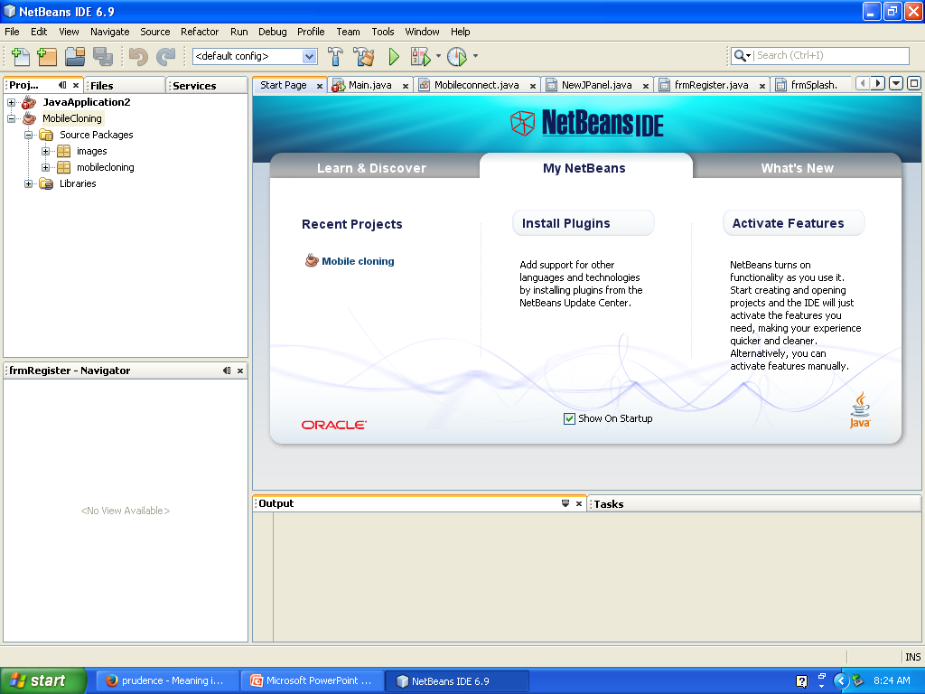
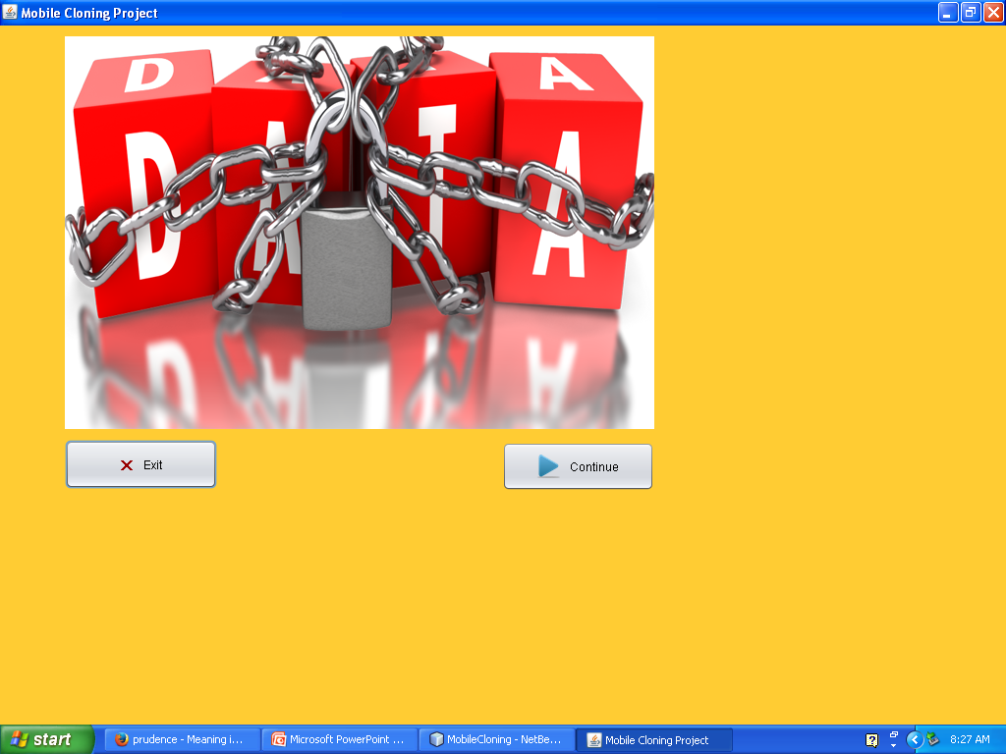
HOW TO RUN THE PROJECT
Open the NetBeans IDE. Click on the project ‘MobileCloning’ and run the project.
After running the project you will get a pop up window. Click on continue.

Slide 19
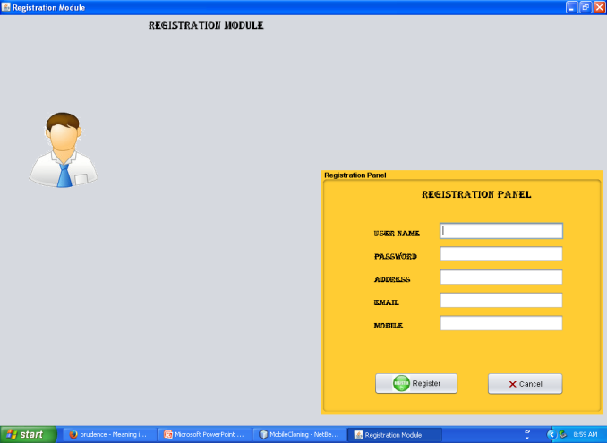
After that you will get a registration window where you have to register yourself.
If the cloning of number exists then it will detect the cloned number and its account will be blocked instantly.

Slide 20
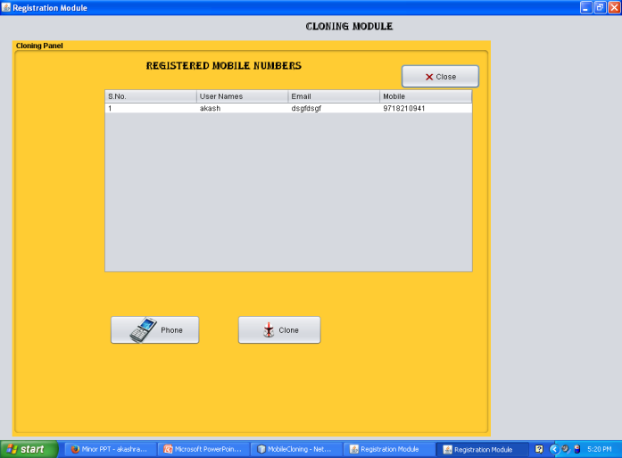
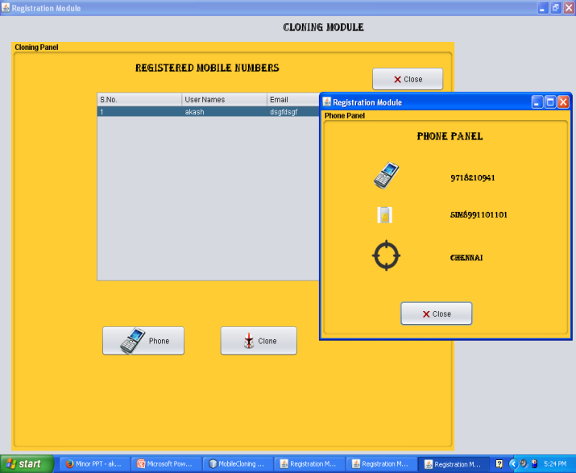
When you click on the show cloning a window appears which contain all the data registered to it.
After getting the register window select a contact to which you want to detect the cloning and click on the phone button which shows the details of the fair registered user and its location.

Slide 21
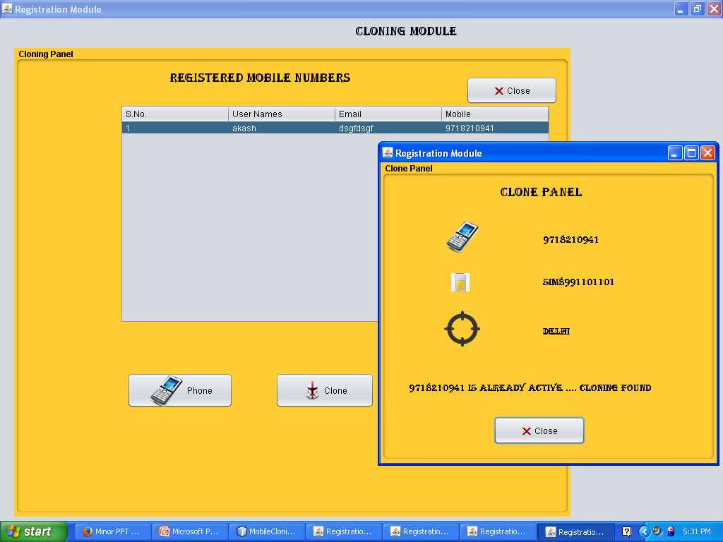
Now click on the clone button it detect the fake user because with the same contact and MIN no different location is found which is not possible. Hence it shows cloning.

Slide 22
PROS
You can have a backup of your card in case you lose your phone.
You can use the same Phonebook on all your numbers on the SIM in your cloned card.
You can have different Network providers on the same clone (but only one will always be active).
It is a handy option when you are traveling and would rather use a cheap phone instead of your more expensive high-end version, in case it gets lost or stolen.

Slide 23
CONS
Cellular thieves can capture ESN/MINs using devices such as cell phone ESN Reader or Digital Data Interpreters (DDI).
By stealing someone else's Mobile Identification Number (MIN) and Electronic Serial Number (ESN), a person can "clone" a cellular phone and then make calls which are charged unlawfully to another.
This is clearly illegal and is essentially a ‘fraud’.

Slide 24
CONTD….
This phenomenon is especially prevalent in drug crimes. Drug dealers need to be in constant contact with their sources of supply and their confederates on the streets. Traffickers acquire cloned phones at a minimum cost, make dozens of calls, and then throw the the phone away after as little as a days use.
In the same way, criminals who pose a threat to our national security, such as terrorists have been known to use cloned phones to thwart law enforcements efforts aimed at tracking their whereabouts.

Slide 25
IMPACT OF CLONING
Each year , the mobile phone industry loses millions of dollars in revenue because of the criminal actions of persons who are able to reconfigure mobile phones so that their calls are billed to other phones owned by innocent third persons.
Many criminal use cloned cellular telephones for illegal activities , because their calls are not billed to them , and are therefore much more difficult to trace.

Slide 26
HOW TO PREVENT CELL CLONING ?
Mobiles should never be trusted for communicating/storing confidential information.
Always set a Pin that's required before the phone can be used.
Check that all mobile devices are covered by a corporate security policy.

Slide 27
REFERENCES
  Trickdad - SIM Cloning Tutorial - http://www.trickdad.com/2012/09/sim-cloning-tutorial.html
  Security Tube - Cloning Simcards And Hacking Payphones - http://www.securitytube.net/video/194
  How To Clone Any SIM Card - http://iyowun.wordpress.com/2009/07/04/how-to-clone-any-sim-card/
  The Complete Reference – Java (7th Edition) – Herbert Schildt – Tata McGraw Hill
  Dream.In.Code – Creating A Server To Serve Clients - http://www.dreamincode.net/forums/topic/38672-creating-a-server-to-serve-clients/

Slide 28


